Slide 1
The Large-Scale Structure of Networks

Slide 2
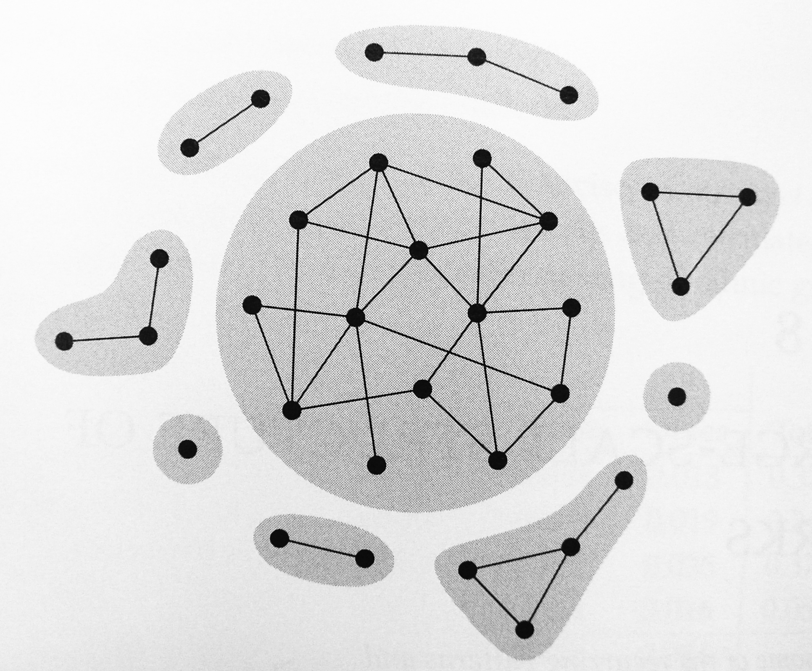
Components
In an undirected network, there is typically a large component that fills most of the network.
Giant Component

Slide 3
Components
The network of film actors
  There is an edge between two actors if they have ever appeared in the same movie.
  Newman et al.(2001) found that 440,971 out of 449,913 actors were connected together in the largest component, or about 98%.
S: the fraction of the largest component of total network size.
  For directed networks, it is the size of the largest weakly connected component.

Slide 4
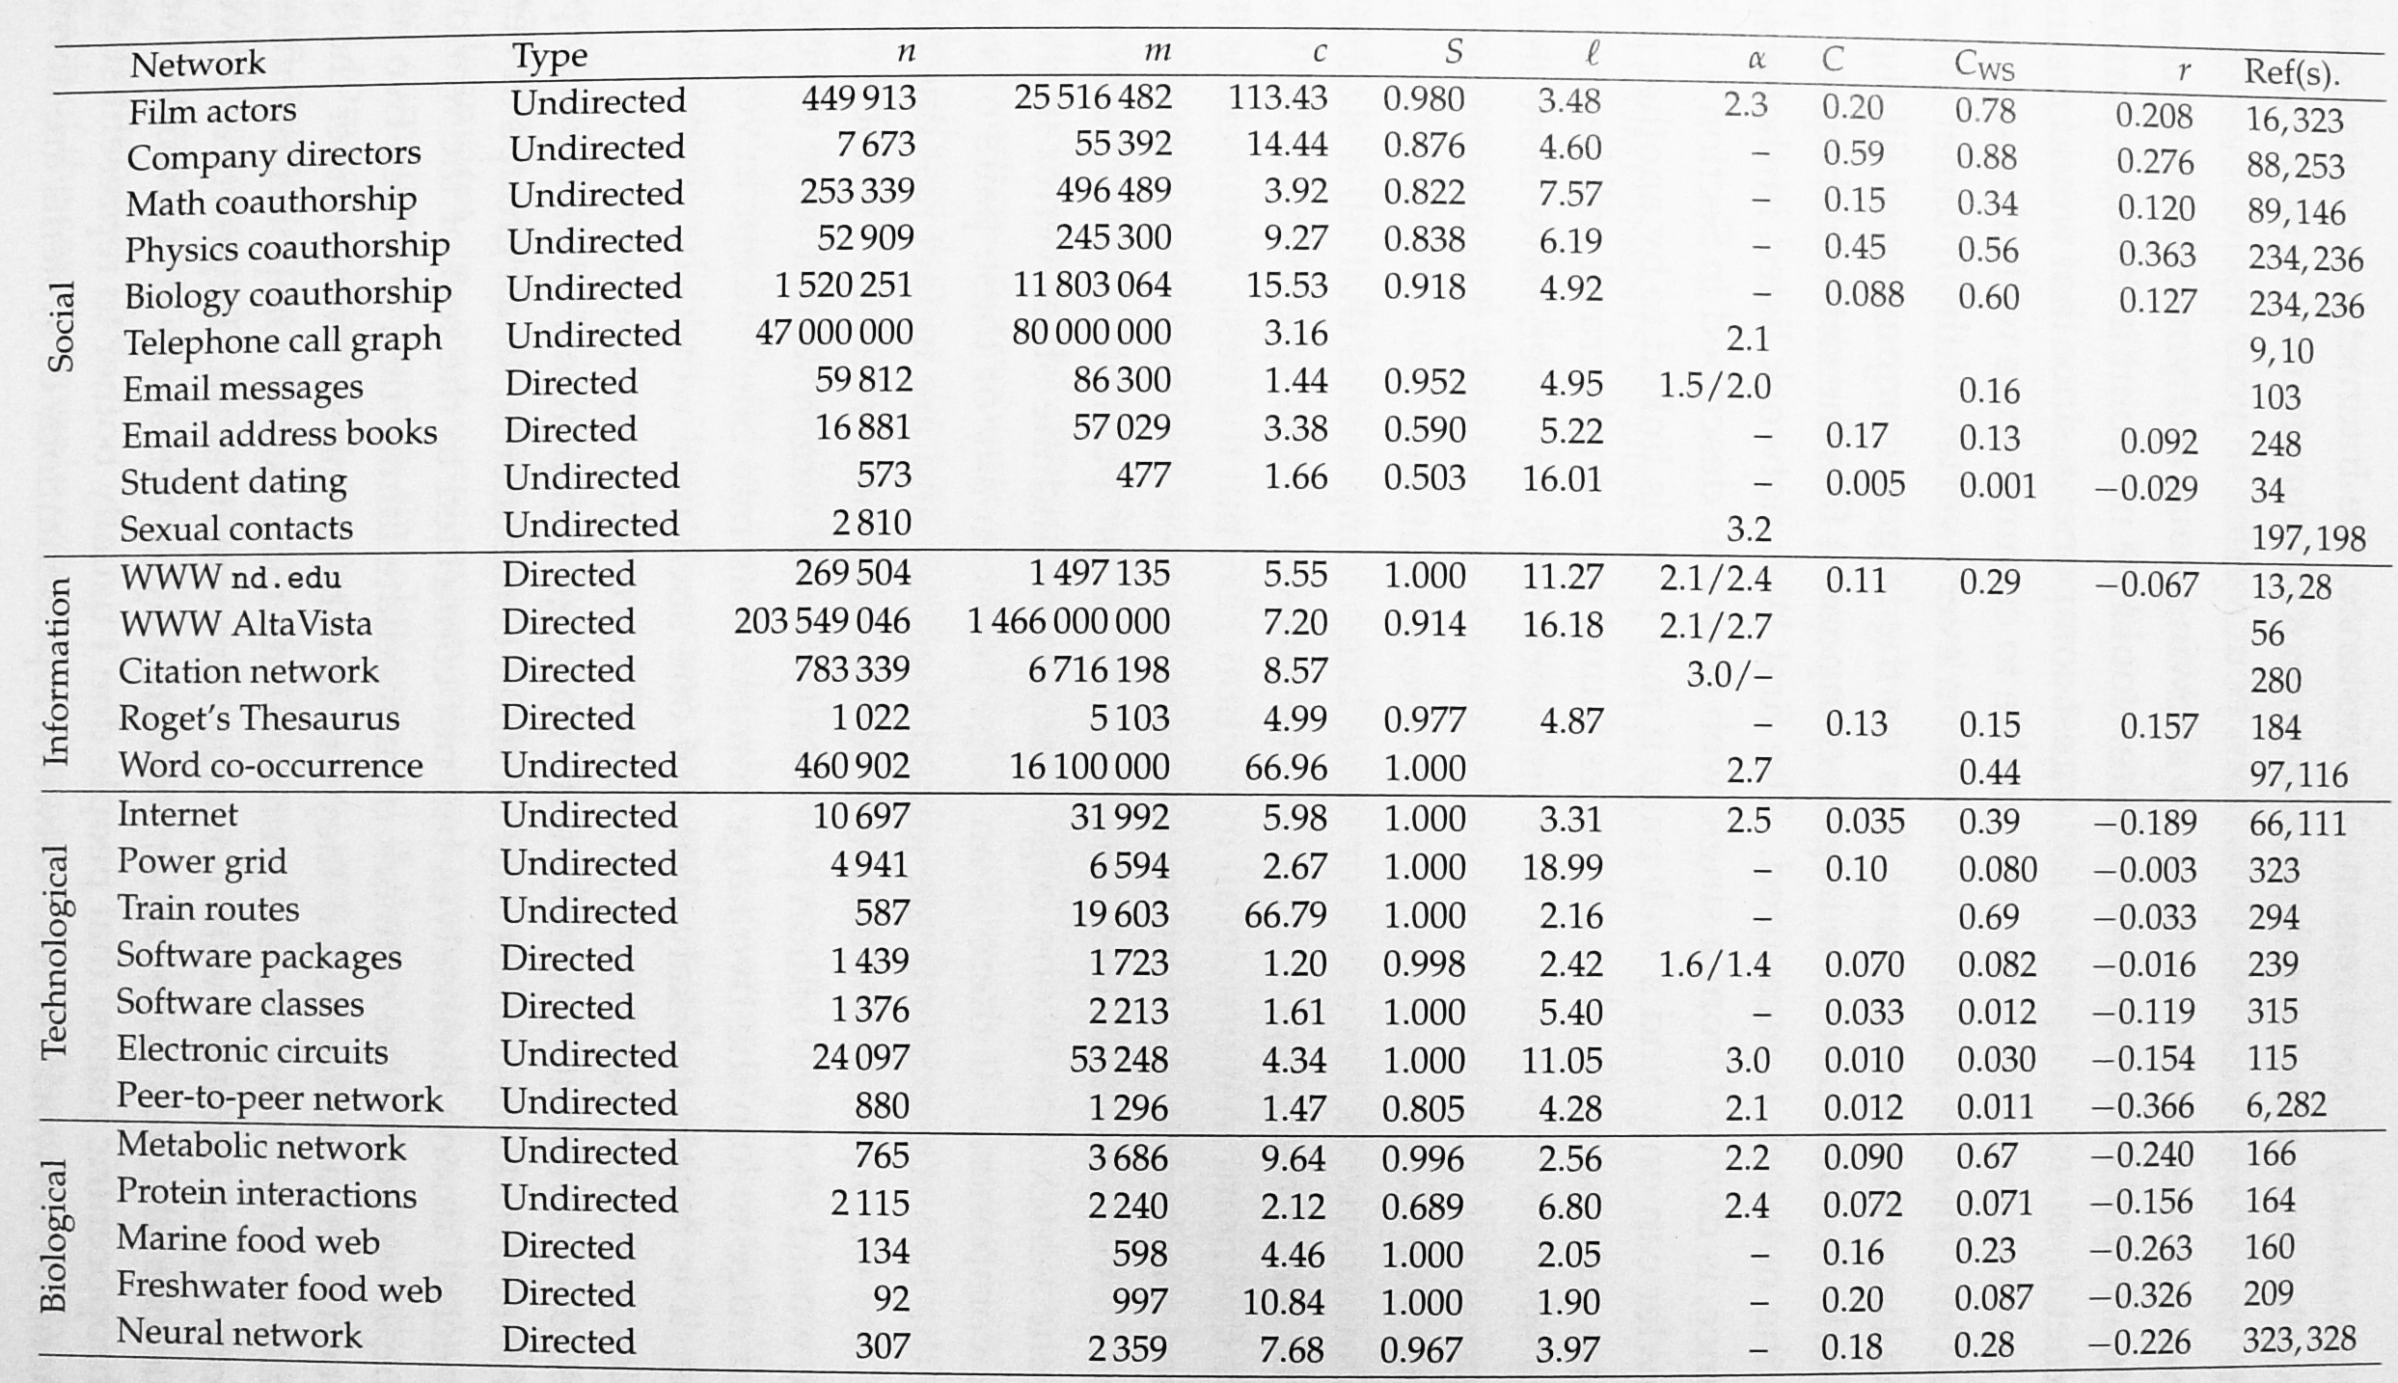
Components

Slide 5
Components
A network usually does not have two or more large components that fill a sizable fraction. (Why?)
Assume that there is a network of n vertices and divided into two large components of about n/2 vertices each.
If there is an edge between any of n²/4 possible pairs, the two components are joined together.

Slide 6
Components in Directed Networks
Directed graphs have weakly and strongly connected components.
Weakly connected: ignored the directed nature of edges.
Strongly connected: there is a directed path from every vertex to any other vertex.
Out-component: the set of vertices that can be reached from any point in the strongly connected component.
In-component: the set of vertices from which the strongly connected component can be reached.

Slide 7
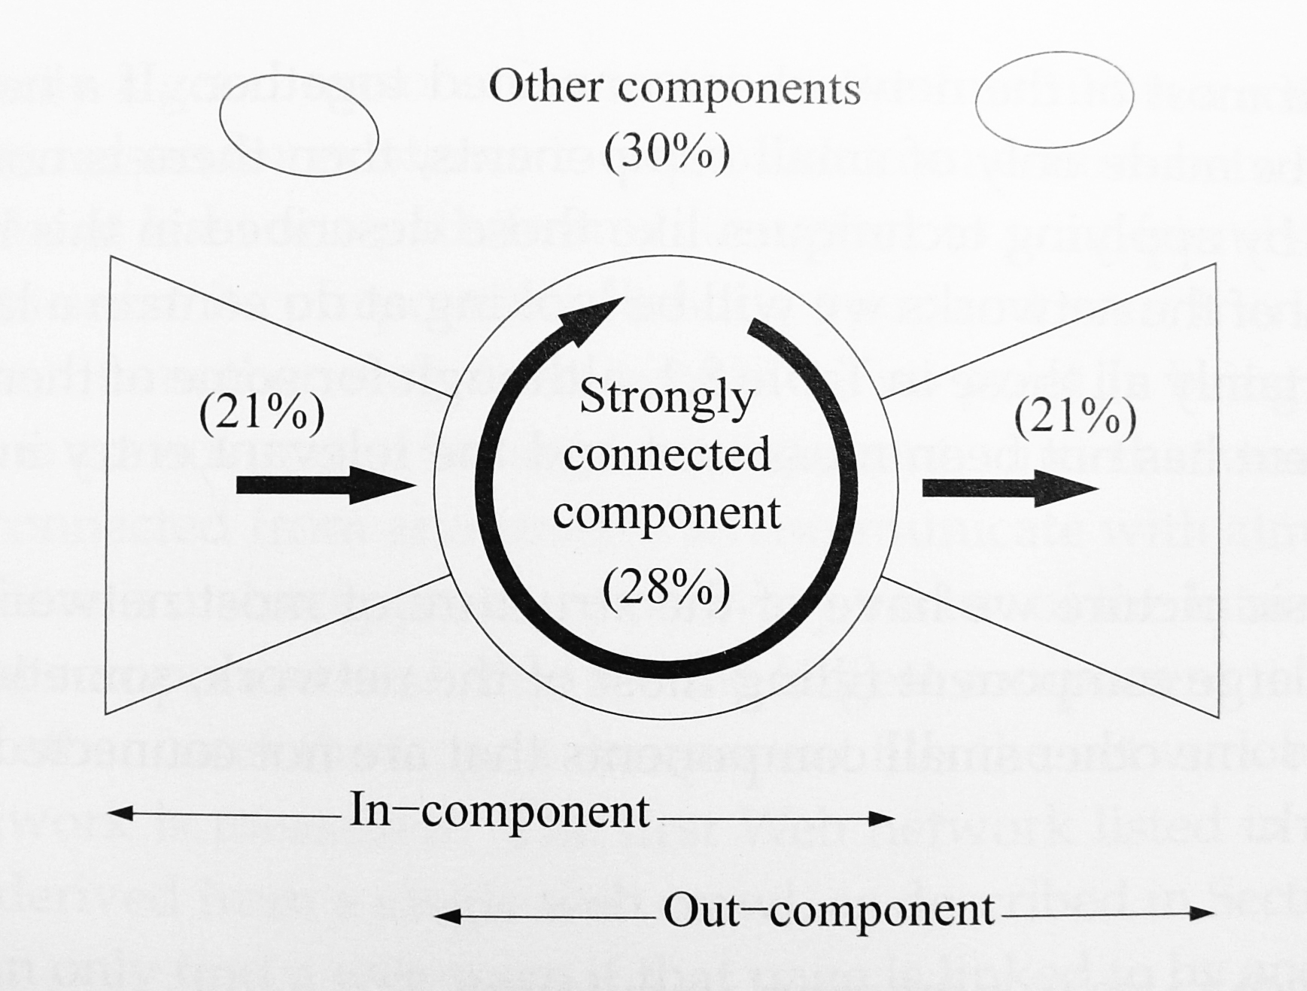
Components in Directed Networks
The bow tie diagram of components in a typical directed network.

Slide 8
Components in Directed Networks
Any acyclic digraph has no strongly connected components.
Citation networks are approximately acyclic, and thus have no large strongly connected components.

Slide 9
Shortest Paths and The Small-World Effect
Small-world effect
  The typical network distances between vertices are surprisingly small.
  Milgram’s experiment (1960s): the letters that made it to the target did so in around six steps on average.
  In Table 8.1, the mean distance is always less than 20 and usually less than 10, even though some of the networks have millions of vertices.

Slide 10
Shortest Paths and The Small-World Effect

Slide 11
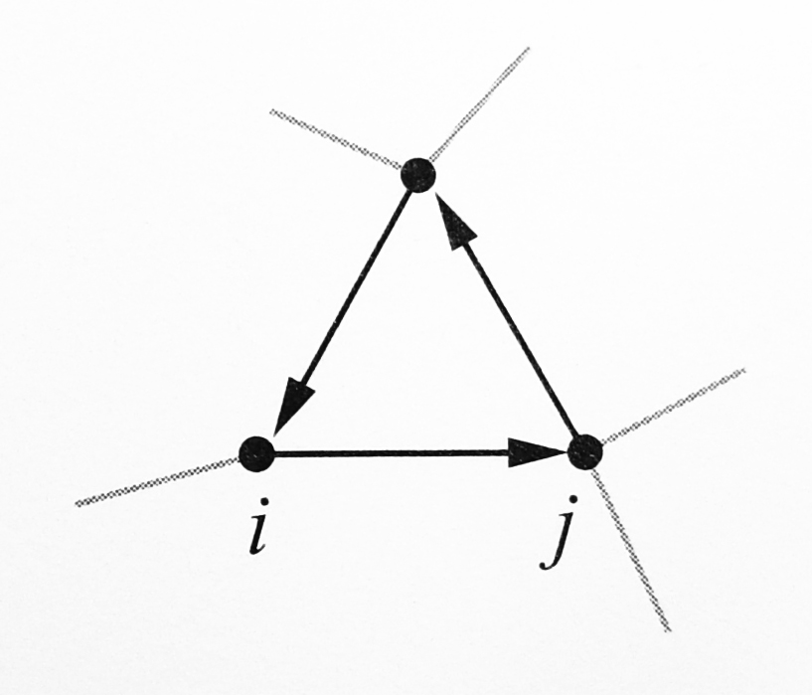
Shortest Paths and The Small-World Effect
Mathematical model (Sec.12.7): the path lengths should typically scale as logn.
For directed networks, in general, the lengths of the shortest paths from i to j and from j to i are different.

Slide 12
Shortest Paths and The Small-World Effect
Scale-free networks: networks with power-law degree distribution.
  Central core contains most of the vertices and has a mean geodesic distance that scales only as loglogn.
  Longer streamers or tendrils: vertices attached to the core like hair, which have length typically of order logn.
  The mean geodesic distance and diameter of networks vary differently with n.

Slide 13
Shortest Paths and The Small-World Effect
Funneling effect.
Sociemetric superstar (by Milgram)
One or two of your acquaintances
  Especially well connected.
  Responsible for most of the connection between you and the rest of the world.
Coauthorship network of physicists
  For physicists having five or more collaborators
  48% of geodesic paths go through one neighbor of the average vertex.
  52% are distributed over the other four or more neighbors.

Slide 14
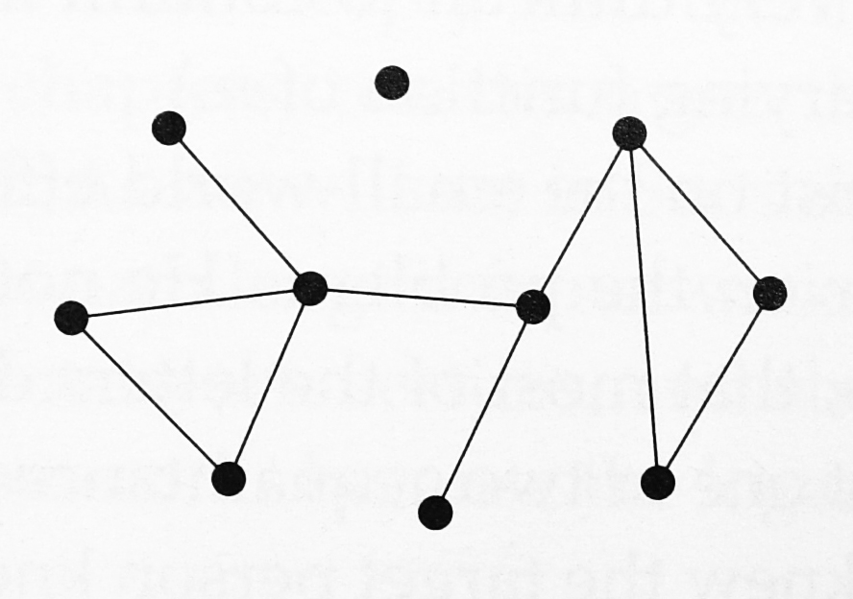
Degree Distributions
Consider undirected networks first.
Define p_{k} as the fraction of vertices that have degree k.
Degree distribution of the network.
0
3
1
4
2
2
3
2
2
1

Slide 15
Degree Distributions
p_{k} can be viewed as the probability that a randomly chosen vertex has degree k.
Degree sequence: {k₁,k₂,k₃,…} of degrees for all the vertices.
0
3
Degree Sequence:
{0,1,1,2,2,2,2,3,3,4}
1
4
2
2
3
2
2
1

Slide 16
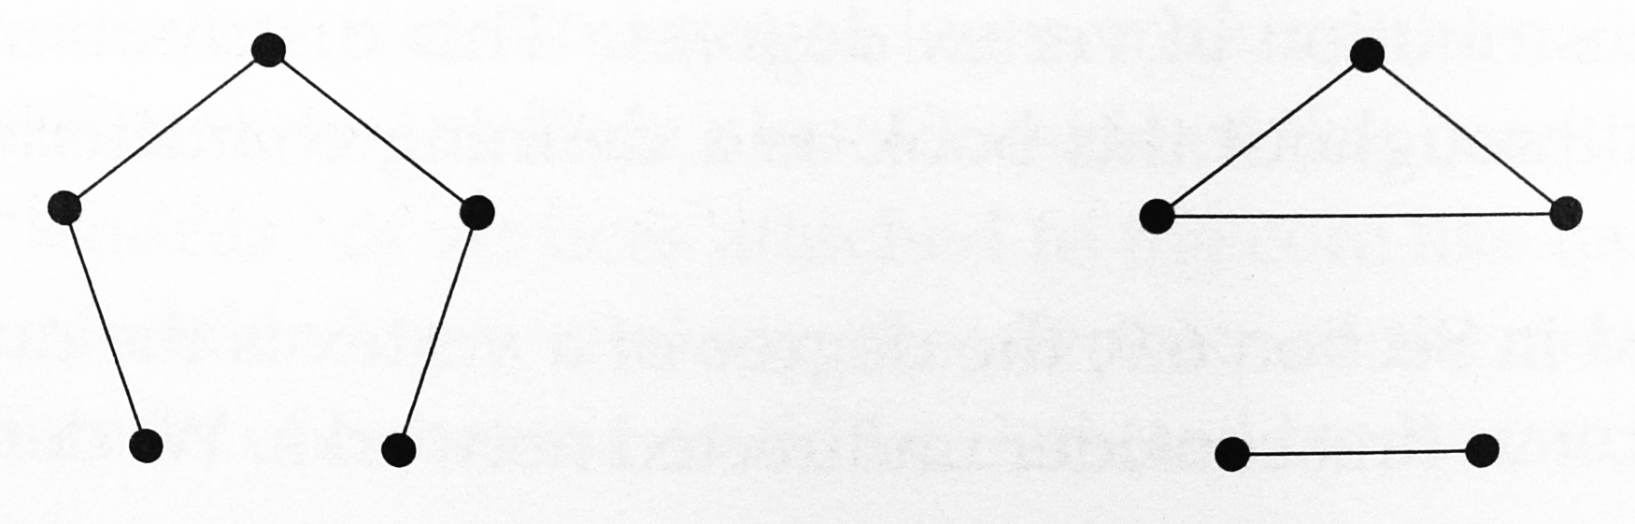
Degree Distributions
In most cases, degree distribution/sequence does not tell use the complete structure of a network.
These two networks are different but have the same degrees.
2
2
2
2
2
2
1
1
1
1

Slide 17
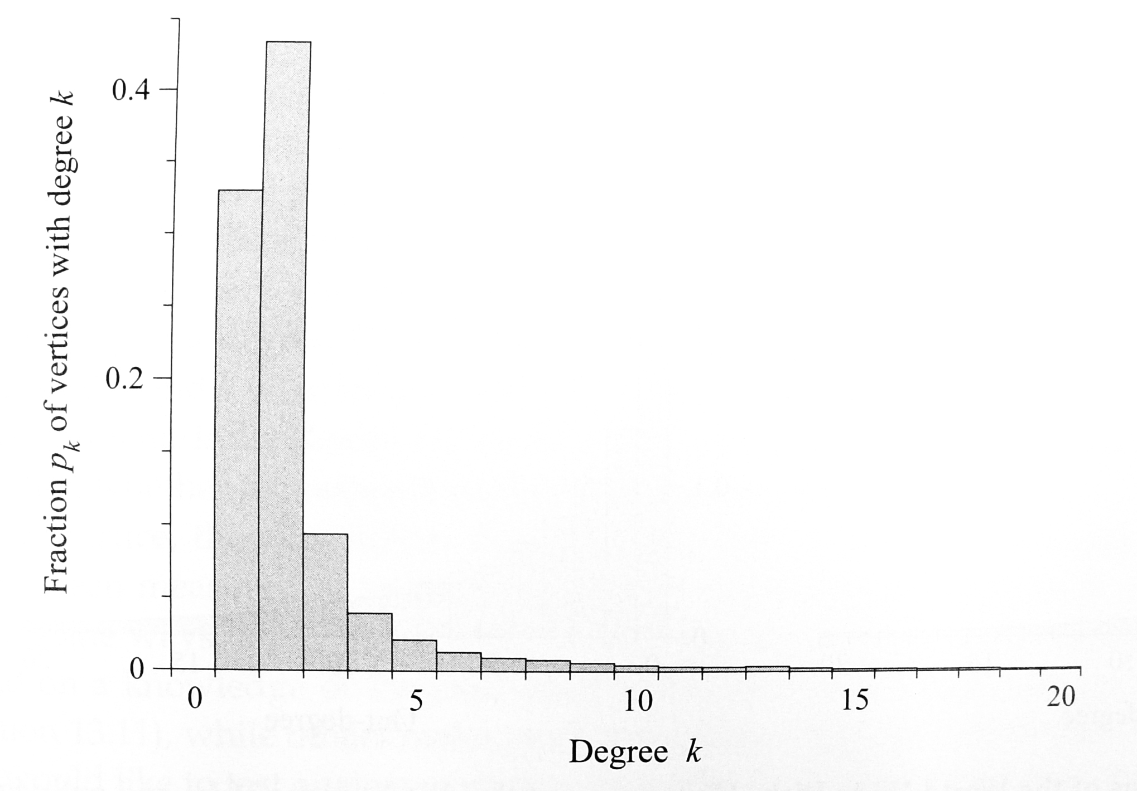
Degree Distributions
Degree distribution of the Internet graph.
Most of the vertices have low degree.
There is a significant “tail” to the distribution, corresponding to vertices with substantially higher degree.

Slide 18
Degree Distributions
The highest degree vertex has degree 2407.
The most highly connected vertex is connected to about 12% of all other vertices.
Such a well-connected vertex is called a hub.

Slide 19
Degree Distributions
Almost all real-world networks have degree distribution with a tail of high-degree hubs.
In the language of statistics, the degree distribution is called right-skewed.
There are two different degree distributions in a directed network, the in-degree and out-degree distributions.

Slide 20
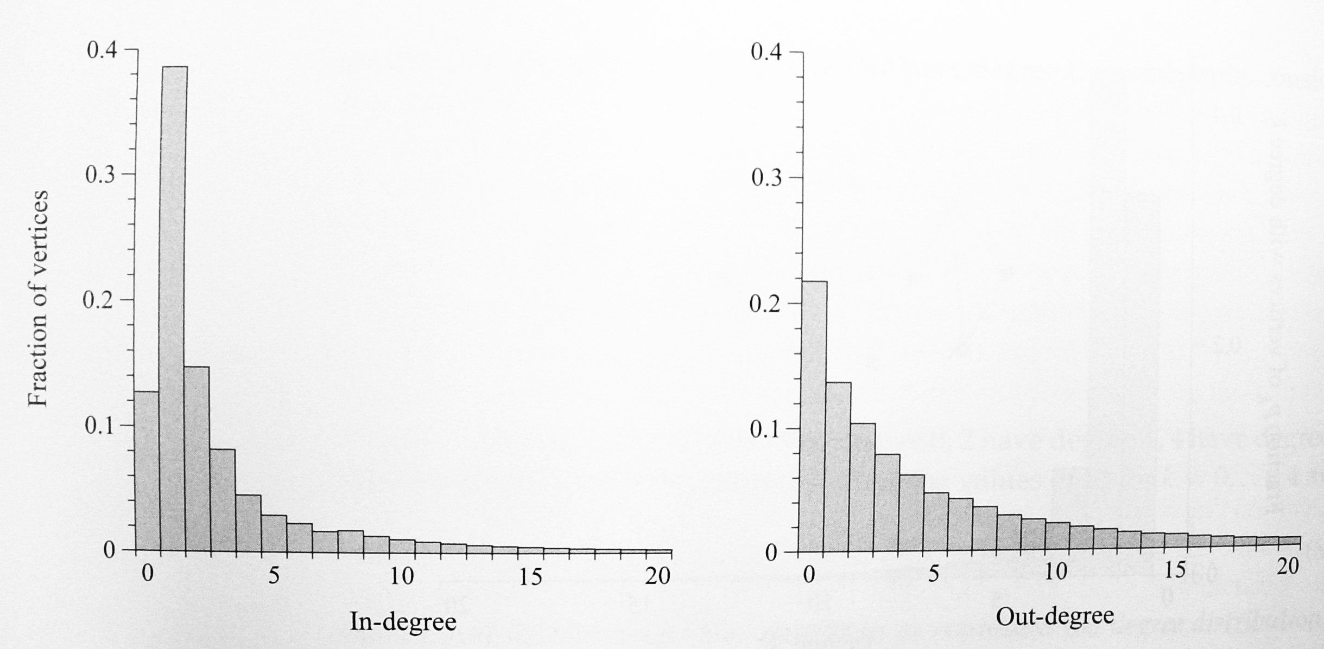
Degree Distributions
In- and out-degrees of pages on the World Wide Web.

Slide 21
Degree Distributions
Joint distribution of in- and out-degrees for directed graphs.
P_{jk}: Fraction of vertices having simultaneously an in-degree j and out-degree k.
In practice, the joint in/out degree distribution has rarely been measured or studied.

Slide 22
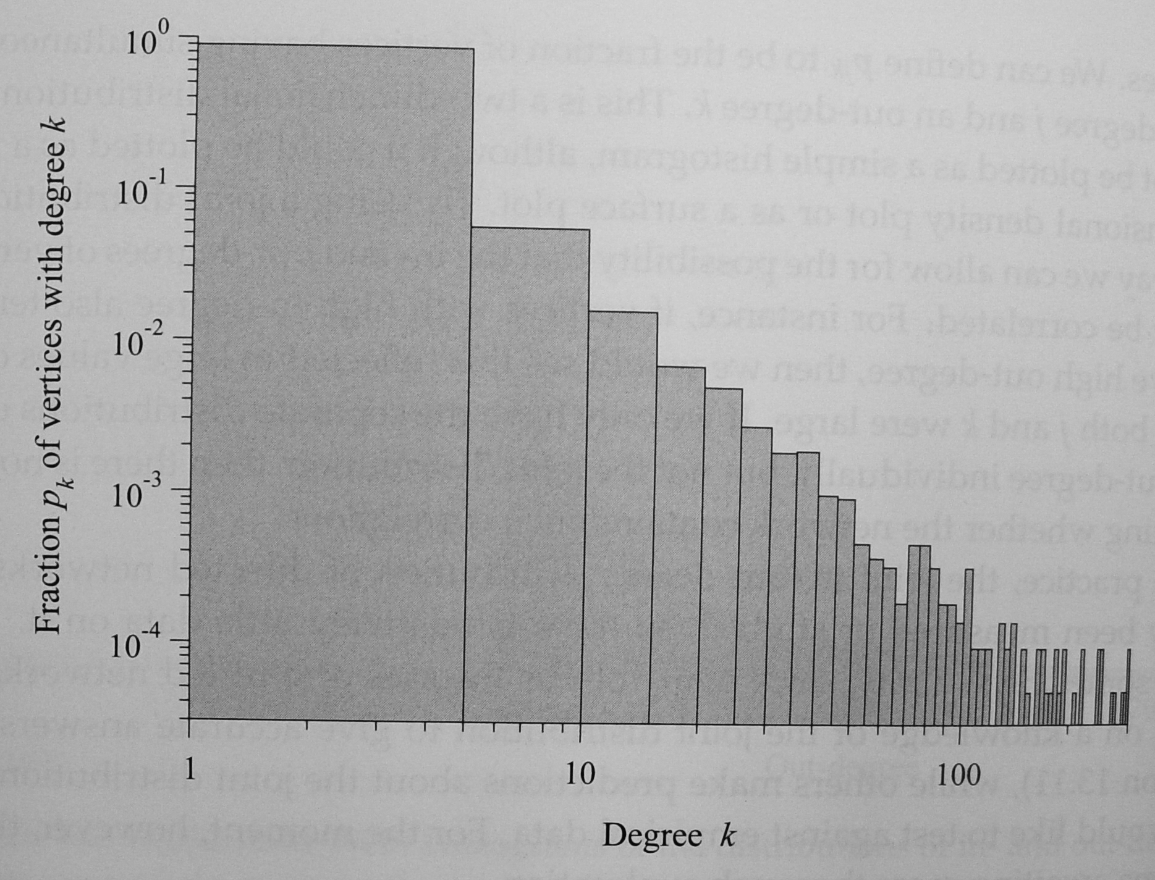
Power Laws and Scale-Free Networks
Degree distributions of the Internet graph, plotted on logarithmic scales.
Both axes are logarithmic.

Slide 23
Power Laws and Scale-Free Networks
The approximate straight-line form.
The degree distribution roughly follows a power law.

Slide 24
Power Laws and Scale-Free Networks
The logarithm of the degree distribution p_{k} is a linear function of degree k:
The logarithmic relation can be rewritten as
Distributions of this form are called power laws.
: exponent of the power law.
Typical values for :

Slide 25
Power Laws and Scale-Free Networks

Slide 26
Power Laws and Scale-Free Networks
Degree distributions deviate in the small-k regime.
A particular network has a power-law degree distribution: normally means only that the tail of the distribution has the form.
In some cases, the distribution may also deviate for high k as well.
There is often a cut-off that limits the maximum degree in the tail.
Networks with power-law degree distributions are sometimes called scale-free networks.

Slide 27
Detecting and Visualizing Power Laws
In the tail, each bin contains only a few samples.
  This is visible as a noisy signal.
Solutions:
  Use larger bins.
  Use very wide bins in the tail, and narrower ones at the left-hand end. (only 2 different sizes.)
  Use larger and larger bins as we go further out in the tail.

Slide 28
Detecting and Visualizing Power Laws
Logarithmic binning
Each bin is wider than its predecessor by a constant factor a.
The n^{th} bin:
The most common choice: a=2.
  1st bin: (degree=1)
  2nd bin: (degree=2,3)
  3rd bin: (degree=4,5,6,7)

Slide 29
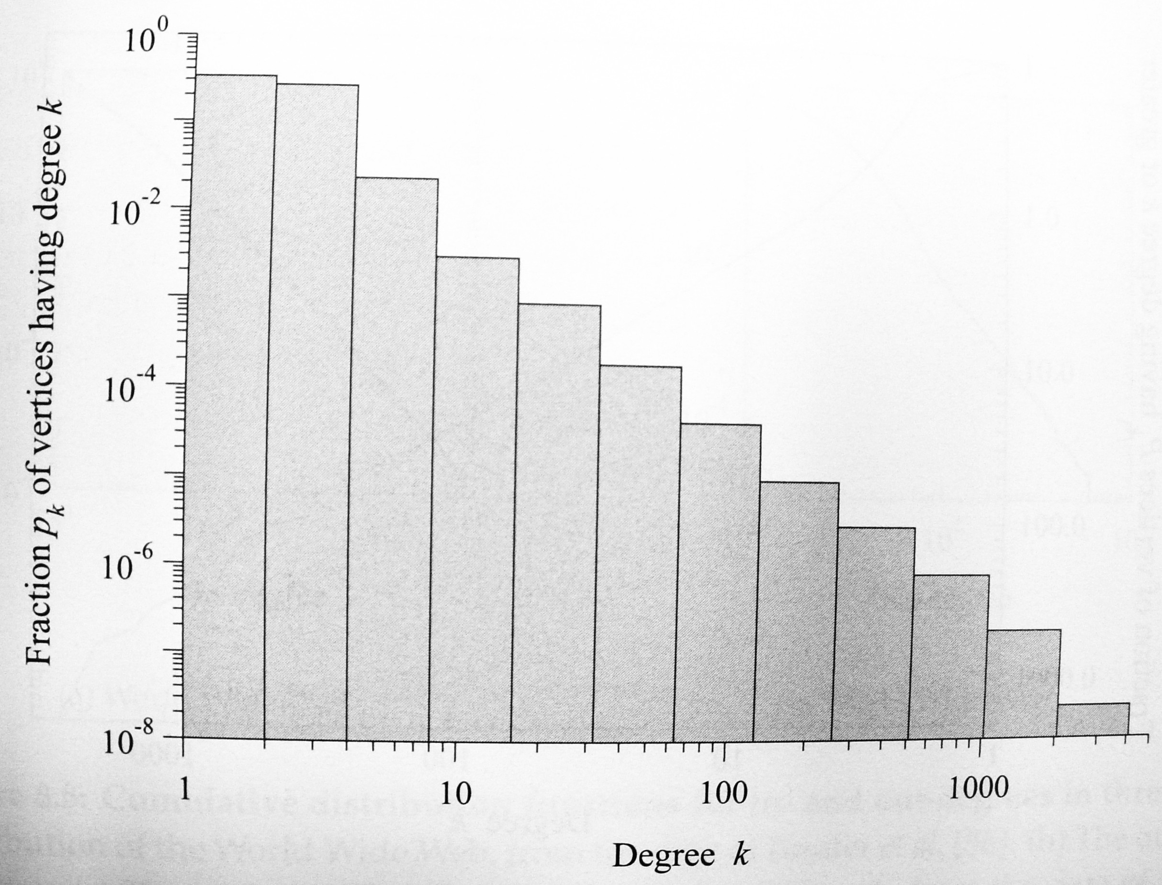
Detecting and Visualizing Power Laws
The bins appear to have equal width.
No bin containing vertices of degree 0.

Slide 30
Detecting and Visualizing Power Laws
Cumulative distribution function:
Fraction of vertices that have degree k or greater.
Suppose that for
The cumulative distribution also follows a power law (with an exponent 1 less than the origin exponent)

Slide 31
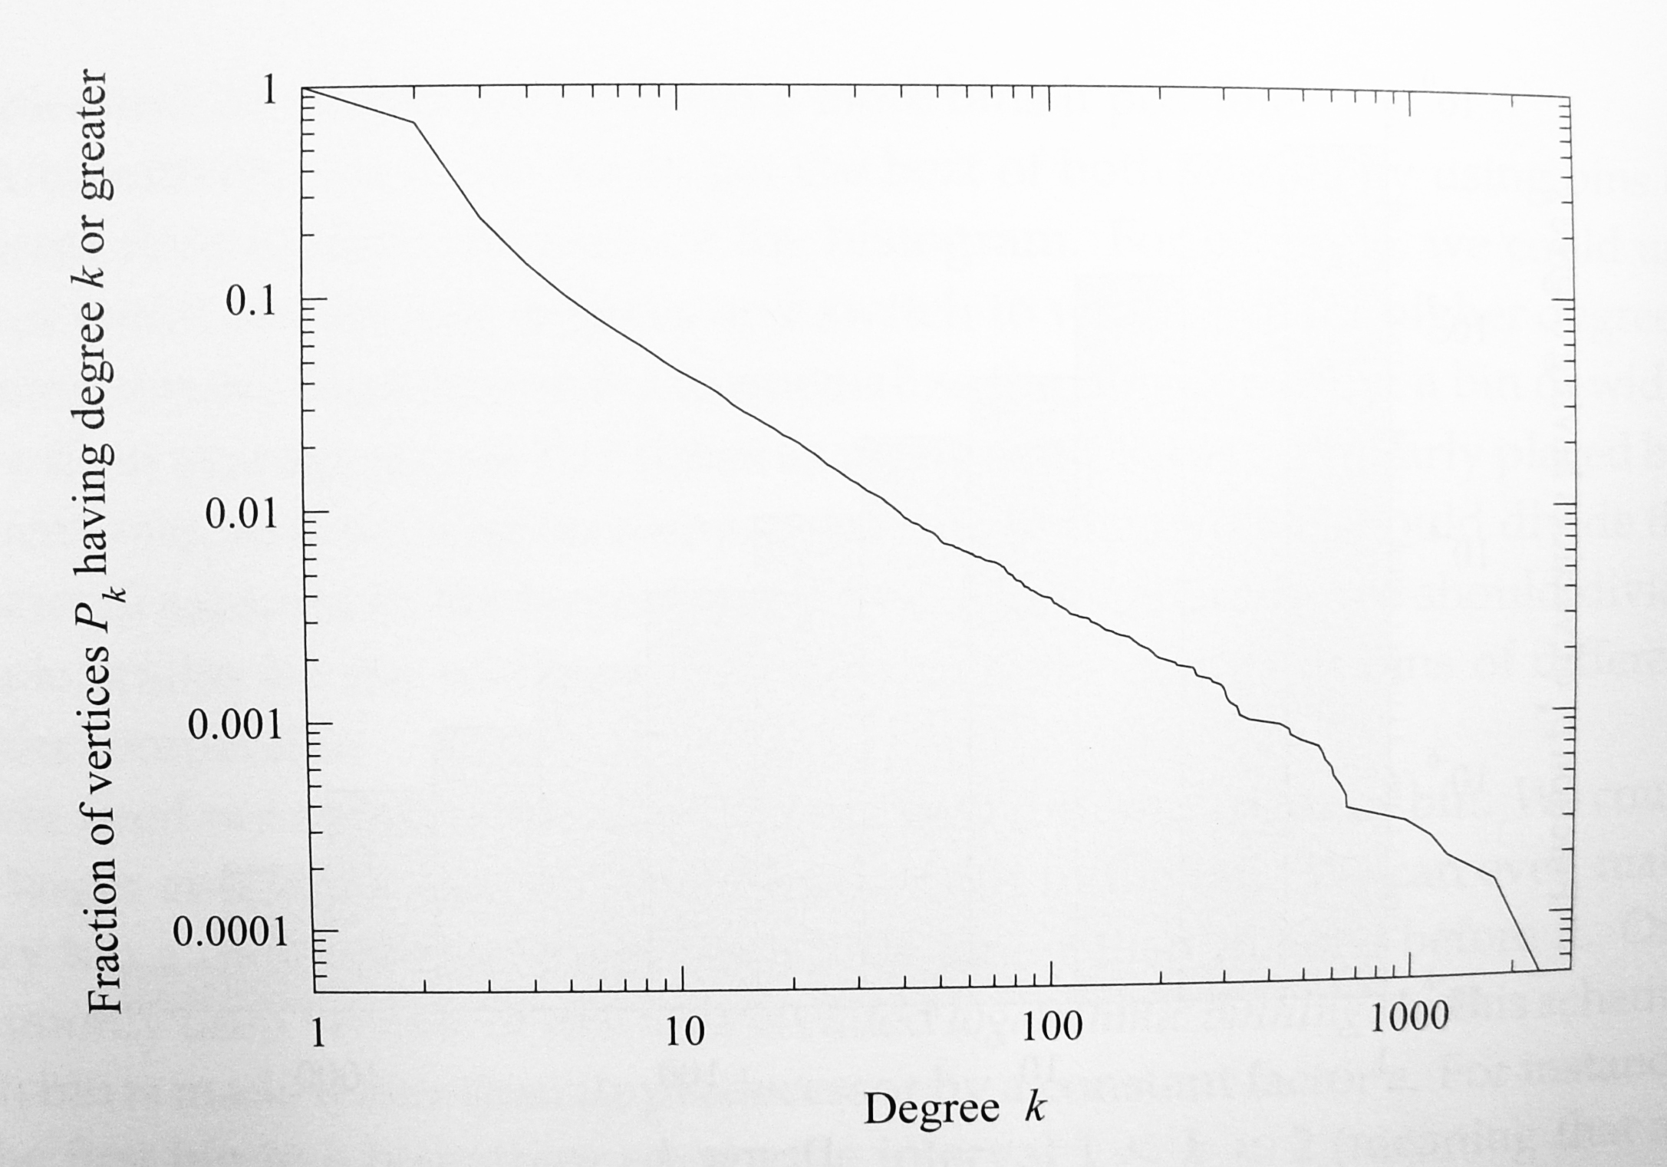
Detecting and Visualizing Power Laws
Cumulative distribution function on log-log scales.
Approximate straight-line form.

Slide 32
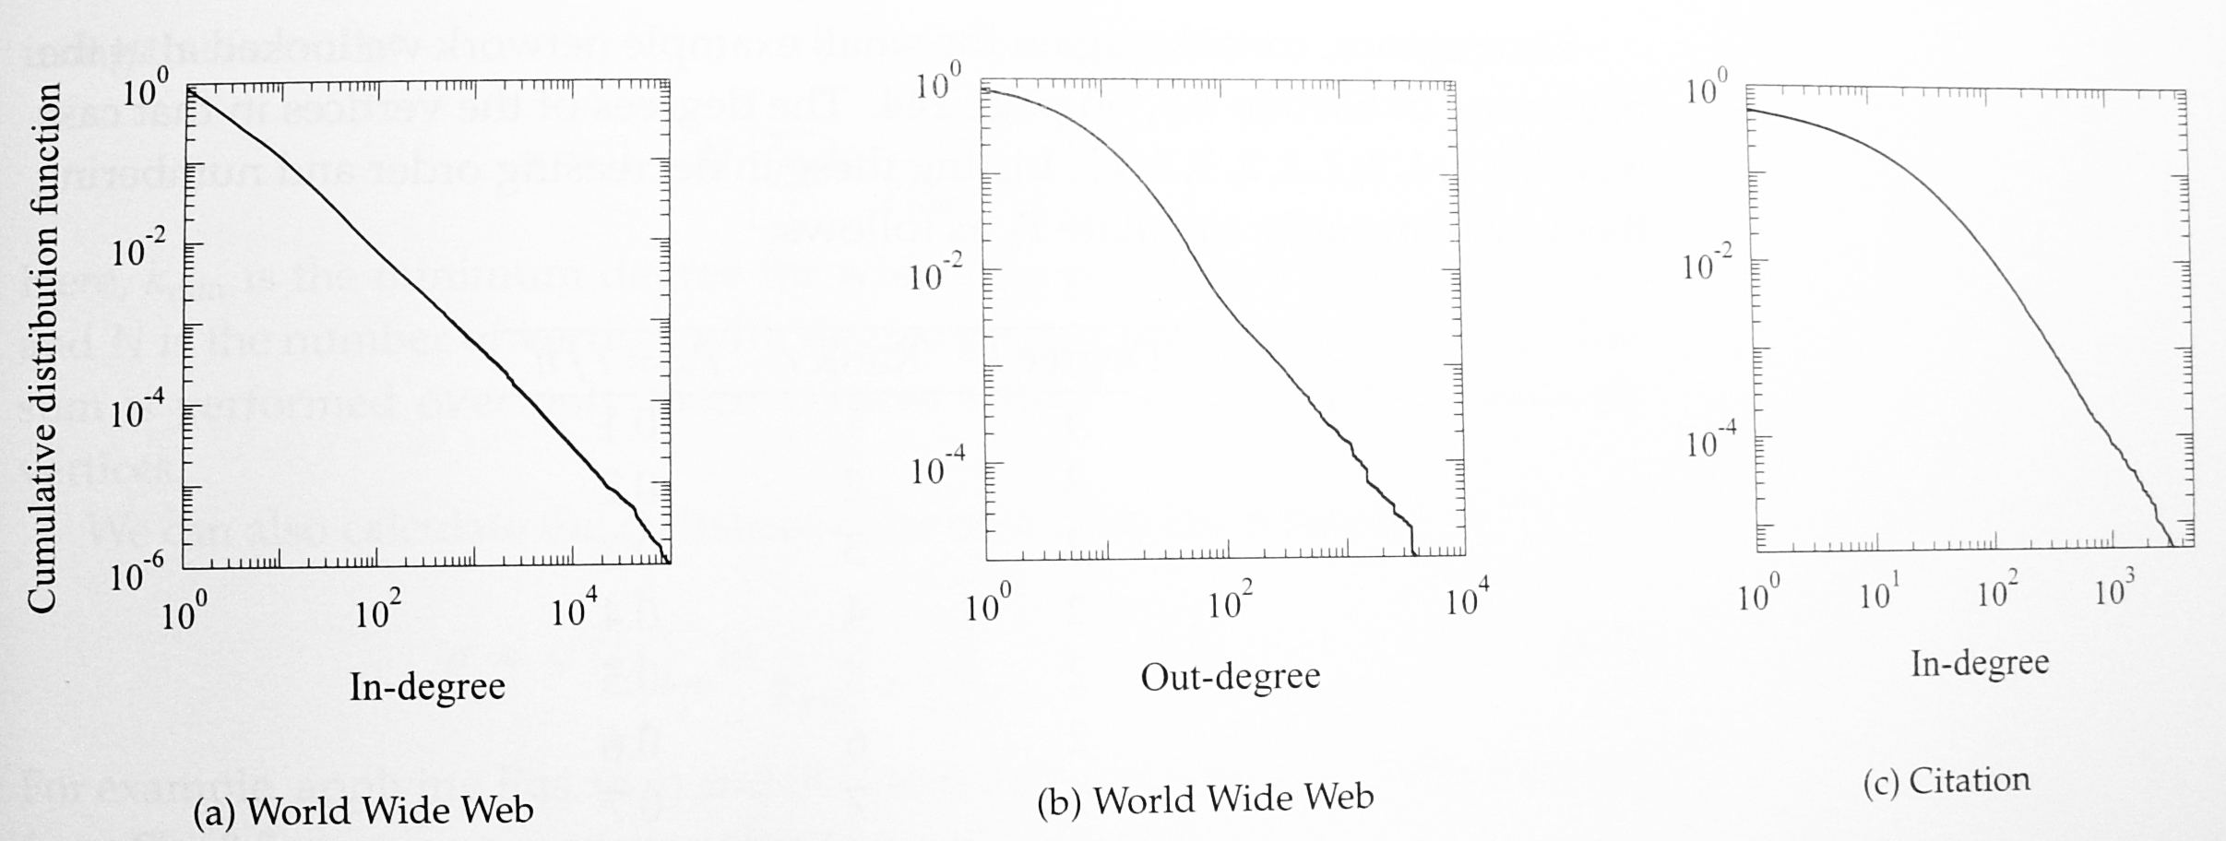
Detecting and Visualizing Power Laws
(a), (b): In-/out-degree distribution of WWW.
(c): In-degree distribution of a citation network.

Slide 33
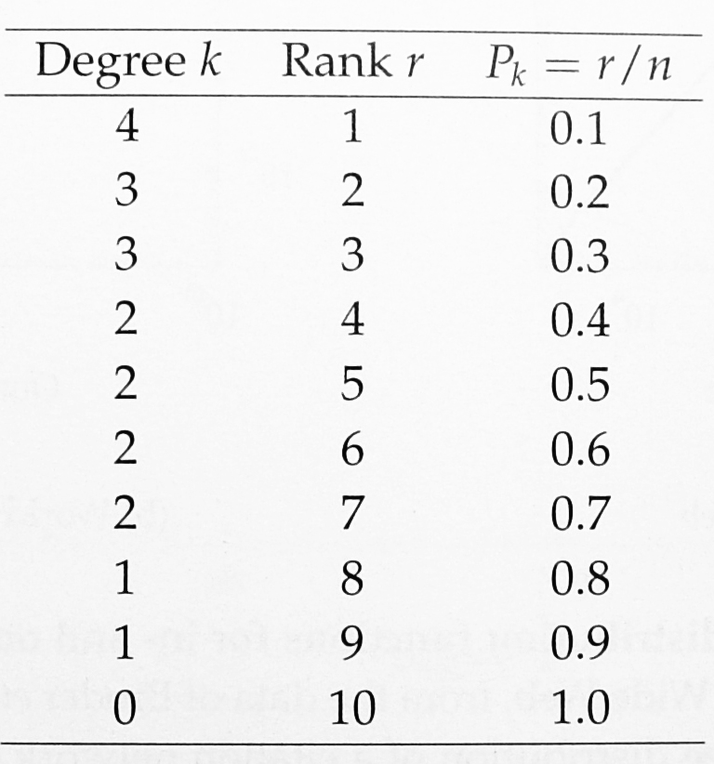
Detecting and Visualizing Power Laws
Rank/frequency plot.
Cumulative distribution function
0
3
1
4
2
2
3
2
2
1

Slide 34
Detecting and Visualizing Power Laws
It is not valid to extract the exponent by fitting the slope.
  Successive points on a cumulative plot are correlated.
  Standard methods such as least squares assume independence between the data points.

Slide 35
Detecting and Visualizing Power Laws
Calculate the exponent directly
  N: Number of vertices with degree
The statistical error on
For the internet graph in Table 8.1,

Slide 36
Properties of Power-Law Distributions
Power laws turn up in a wide variety of places, not just in networks.
  Sizes of city populations, earthquakes, moon craters, solar flares, computer files, and wars.
  Frequency of use of words in human languages, and occurrence of personal names in most cultures.
  The number of papers scientists write, hits on web pages, and species in biological taxa.
  The sales of books, music recordings, and almost every other branded commodity.

Slide 37
Normalization
For a power-law degree distribution,
p₀ is set to be zero. (or p₀ would be infinite)
Then, we have that
where is the Riemann zeta function.
In other words, the normalized power-law distribution is

Slide 38
Normalization
In some cases, we normalize over only the tail:
  : generalized or incomplete zeta function.
In the tail, the sum over k is well approximated by an integral:

Slide 39
Normalization
In this approximation, the degree distribution is
Moreover, the cumulative distribution function is

Slide 40
Moments
The first moment (mean) and the second moment (mean square) are
Suppose we have a degree distribution p_{k} that has a power-law tail for , then

Slide 41
Moments
Approximate the second sum by an integral
The first term is some finite number.
The second term depends on the values of m and .

Slide 42
Moments
The approximation of the m^{th} moment:
For a given , all moments will diverge for which .
The second moment arises in many calculations with networks.
Most real-world networks with power-law degree distribution have values of in the range .
Their second moment should diverge.

Slide 43
Moments
In any real (finite) network, one can calculate the m^{th} moment directly through
and all the moments are actually finite.
When one says the m^{th} moment is infinite:
  For an arbitrary large network with the same power-law degree distribution, the value would be infinite.

Slide 44
Moments
For a simple graph, the approximation would be cut off at k=n so that
In a network with , the second moment diverges as n^{1/2} as the network becomes large.
For the Internet data with about 20,000 nodes, the second moment has the value
which can in practice treated as infinite for many purpose.

Slide 45
Top-Heavy Distribution
W: fraction of ends of edges.
P: fraction of the highest-degree vertices.
For a pure power-law degree distribution,

Slide 46
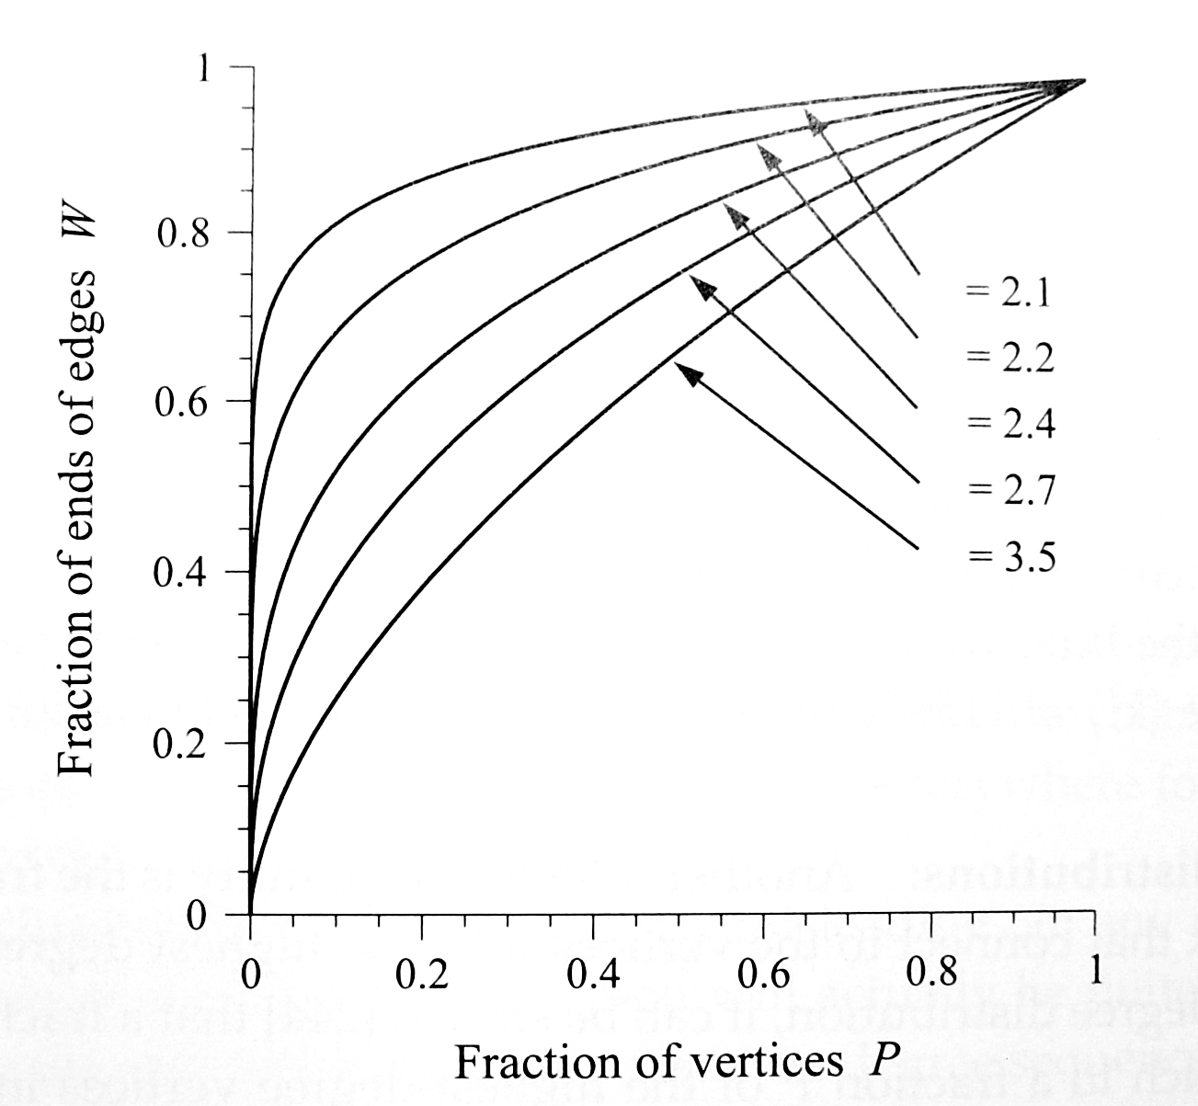
Top-Heavy Distribution
Lorenz curves.
Fast initial increase
  Large fraction of the edges are connected to a small fraction of the highest degree nodes.

Slide 47
Top-Heavy Distribution
The in-degree distribution of the WWW follows a power law with (about)
P=0.50 ➔ W=0.89
  89% of all hyperlinks link to pages in the top half of the degree distribution.
W=0.50 ➔ P=0.015
  50% of all the links go to less than 2% of the “richest” vertices.
The degree distribution is top-heavy
  A large fraction of the “wealth” (incoming links) falls to a small fraction of the vertices.

Slide 48
Top-Heavy Distribution
For the real degree distribution of the Web, 50% of the incoming hyperlinks point to just 1.1% of the richest vertices.
On the Internet, 3.3% of the most highly connected nodes have 50% of the connections.
For paper citations, 8.3% of the highest cited papers get 50% of all the citations.

Slide 49
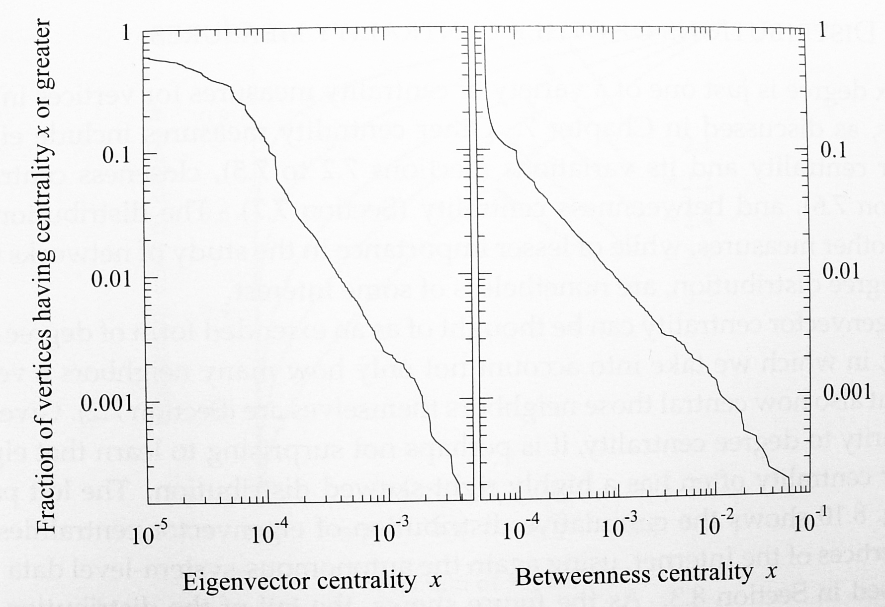
Distribution of Other Centrality Measures
Cumulative Distribution Function for Internet graph
Right-skewed distribution
  Degree centrality.
  Eigenvector centrality.
  Betweenness centrality.
Eigenvector
Betweenness

Slide 50
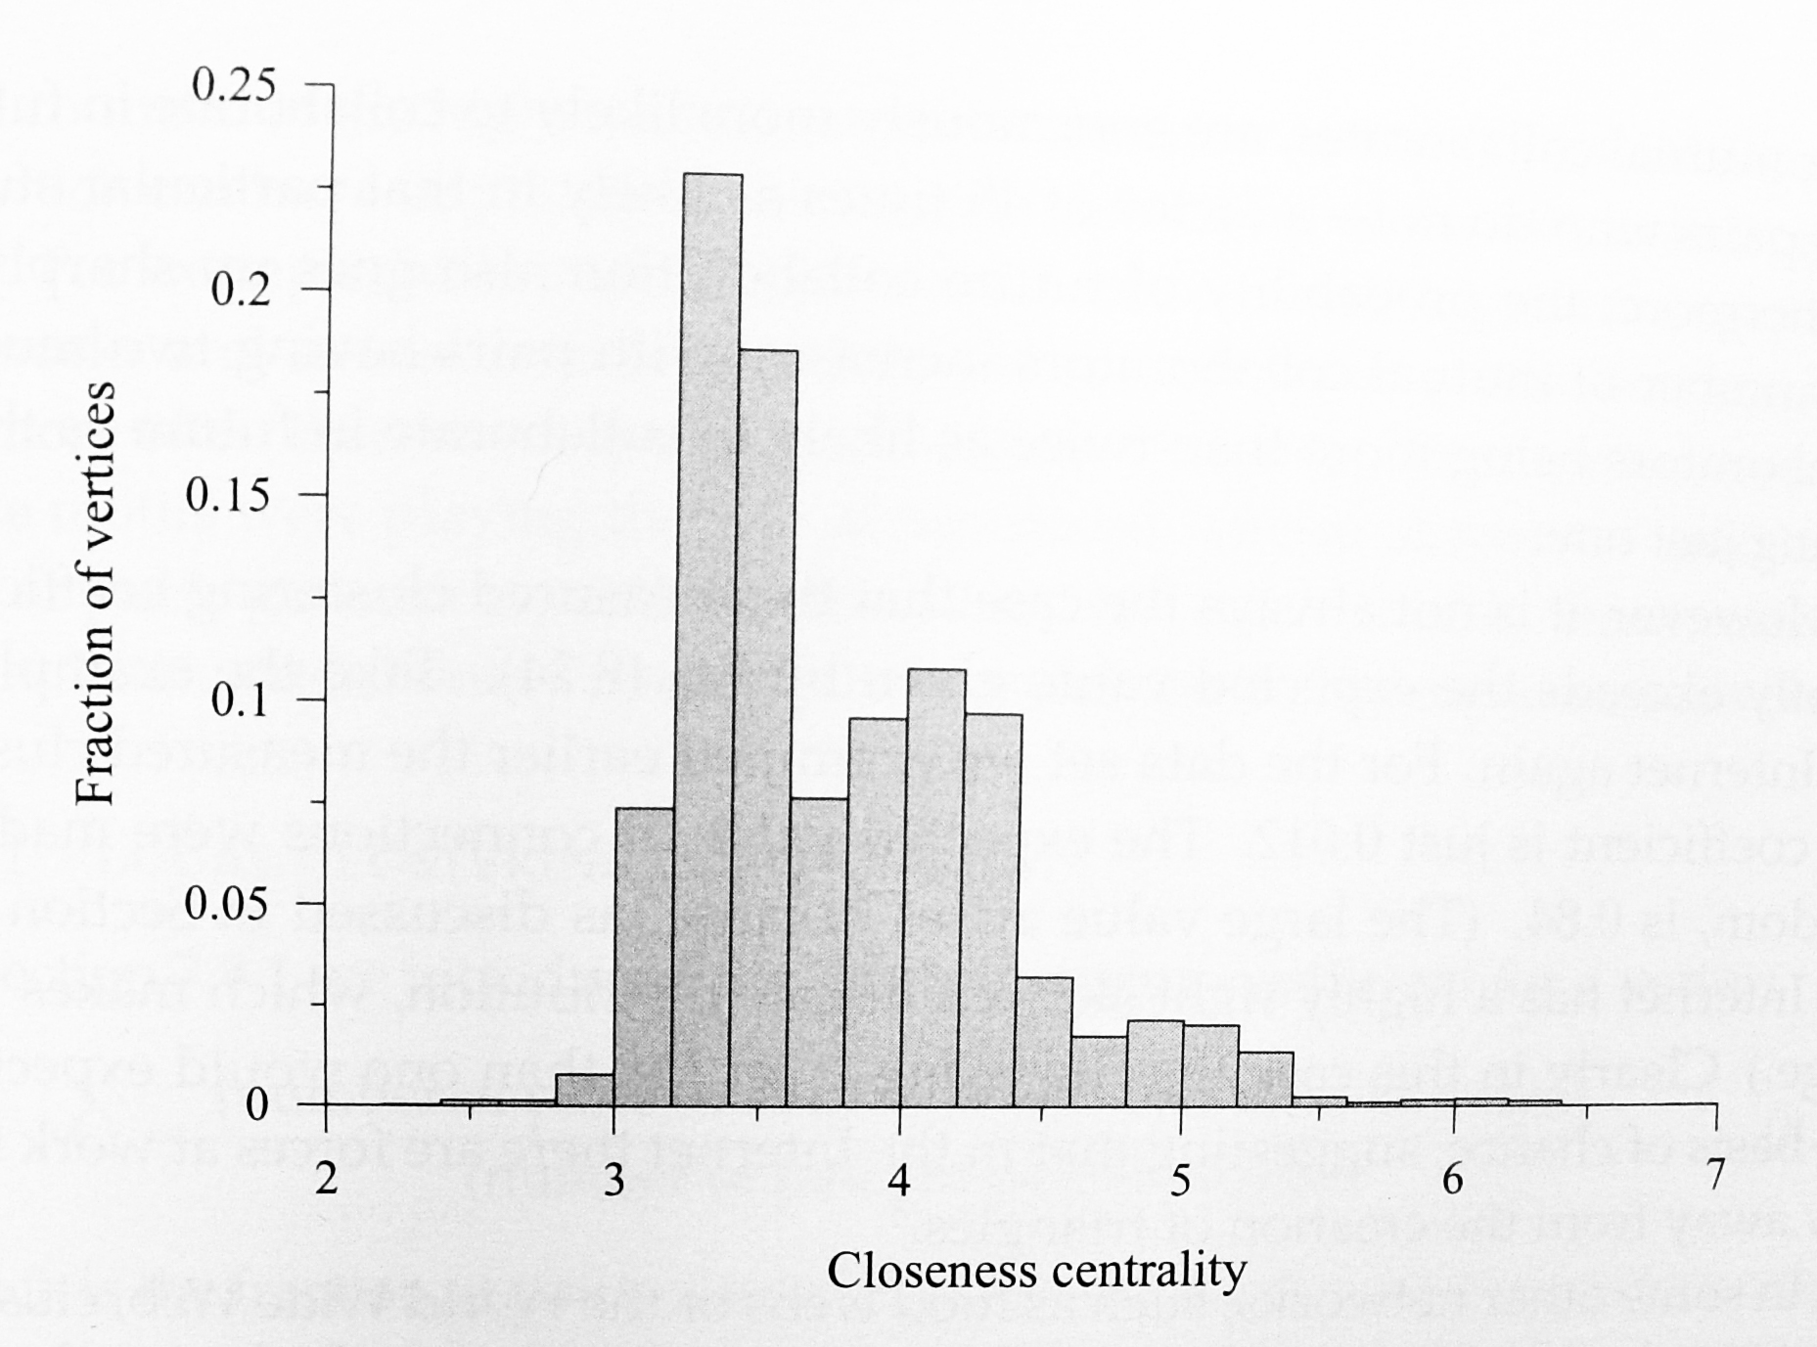
Distribution of Other Centrality Measures
An exception is the closeness centrality.
The range is small (1~logn), and the distribution cannot have a long tail.
Not even roughly monotonically decreasing.
Closeness of Internet graph

Slide 51
Cluster Coefficients
Consider a network with given degree distribution.
If the connections between vertices are made at random, the clustering coefficient is
In networks where and have finite values, this quantity becomes small for large networks.

Slide 52
Cluster Coefficients

Slide 53
Cluster Coefficients
Consider the collaboration network of physicists.
The value would be C=0.0023 if the physicists chose their collaborators at random.
On the other hand, the measured value is C=0.45.
This large difference is indicative of real social effects at work.

Slide 54
Cluster Coefficients
Triadic closure process:
  An “open” triad of vertices is “closed” by the addition of the last edge.
For example, people introduce pairs of their collaborators to one another and those pairs then go on to collaborate themselves.
Sometimes the clustering is far less than expected.
For Internet,
  Expected value (at random): C=0.84
  Measured value: C=0.012.

Slide 55
Clustering Coefficients
We can also look at the densities of other small groups of vertices (motif).
In genetic regulatory networks and neural networks, certain small motifs occurred far more often than was expected by chance.
Milo et al.(2002) conjectured that these motifs were playing the role of functional “circuit elements”, such as filters or pulse generators.

Slide 56
Local Clustering Coefficient
Local clustering coefficient C_{i} for vertex i:
  The fraction of pairs of neighbors of vertex i that are themselves neighbors.
It has been conjectured that plots of this type take either the form
or the form .

Slide 57
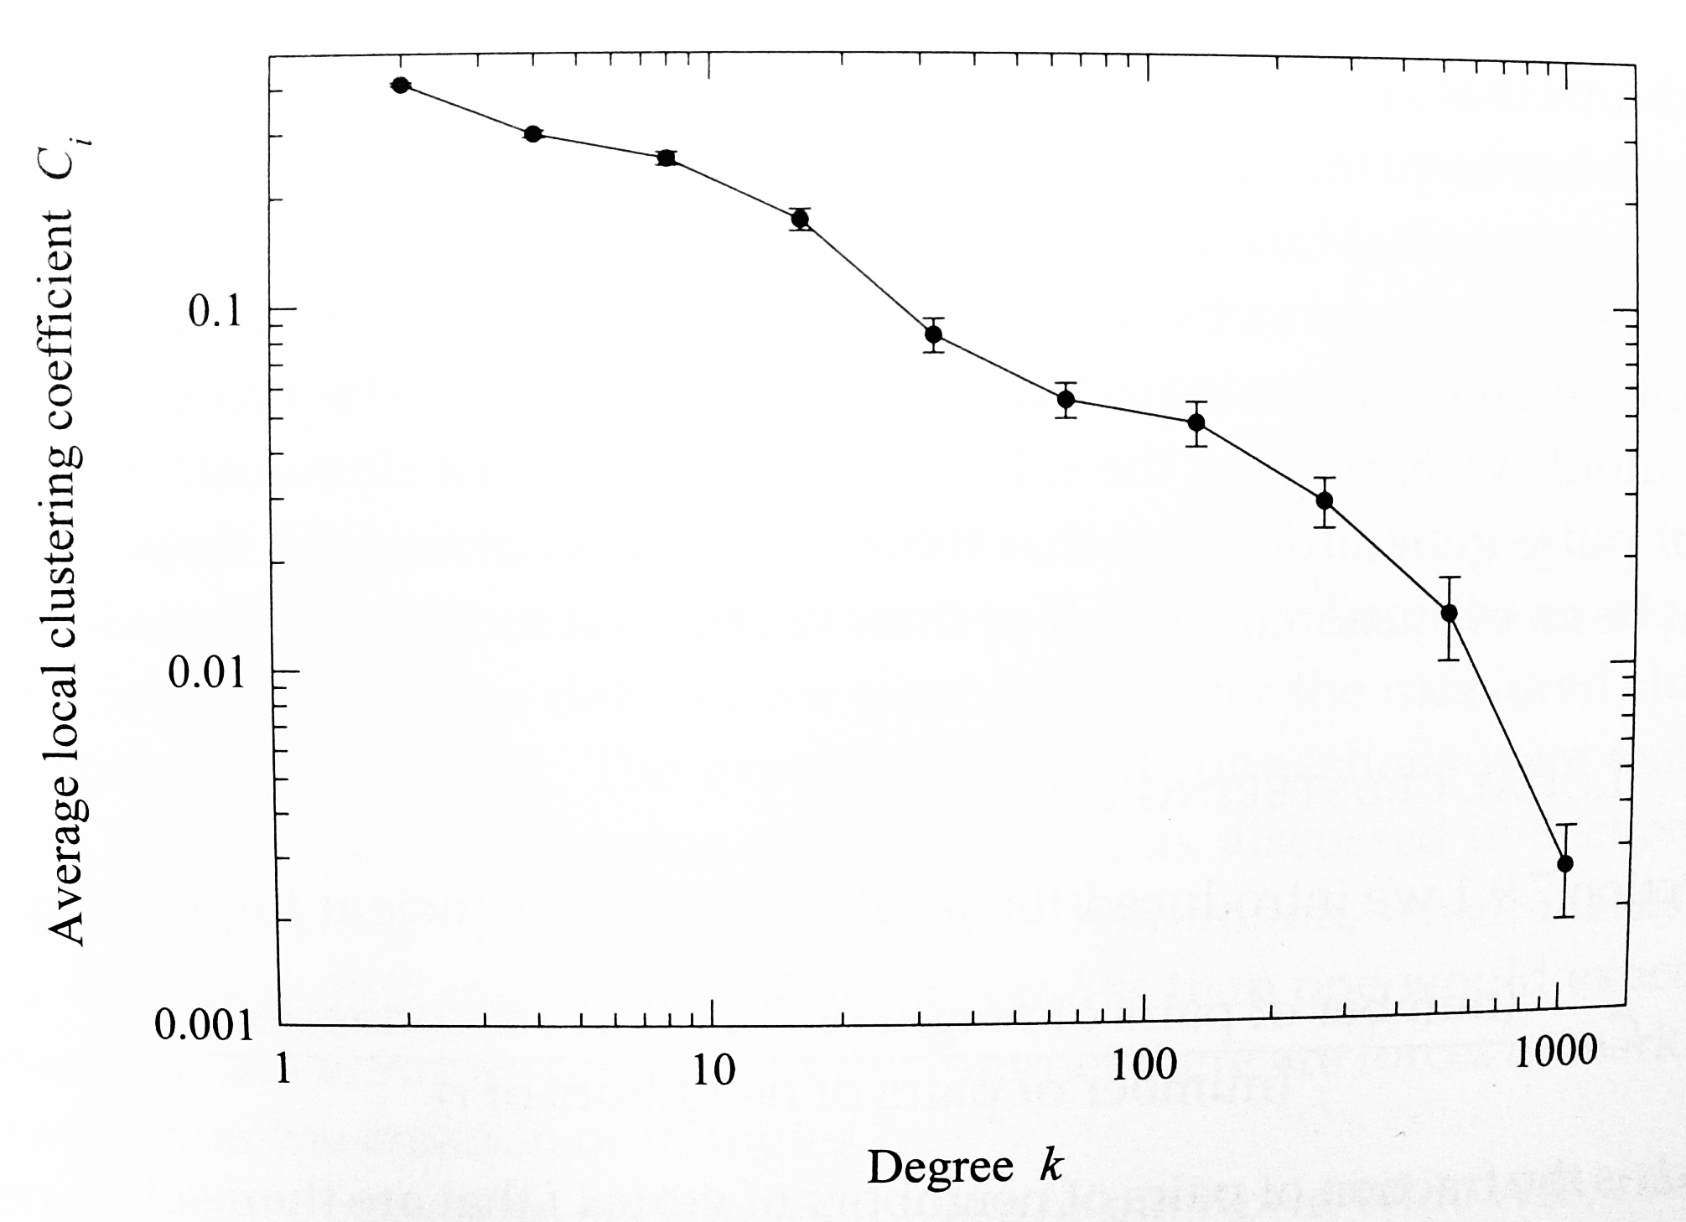
Local Clustering Coefficient
Average local clustering coefficient of Internet graph

Slide 58
Assortative Mixing
Assortative mixing or homophily:
  Tendency of vertices to connect to others that are like them in some way.
Assortative mixing by degree can be quantified by correlation coefficient:
The double sum over i and j has n² terms and is slow to evaluate.

Slide 59
Assortative Mixing
The computational complexity can be reduced through an alternative form:
(m terms)
(n terms for each)

Slide 60
Assortative Mixing
Maslov et al.(2004) show that simple graphs tend to show disassortative mixing by degree (r<0)
  The number of edges that can fall between high-degree vertex pairs is limited.

Slide 61
Assortative Mixing
Social networks are assortatively mixed (r>0).
  They tend to be divided into tightly knit groups.
  Vertices in small groups tend to have lower degree than vertices in larger groups.
  Hence, the low-degree vertices will tend to be connected to other low-degree vertices, and similarly for high-degree ones.

Slide 62
Assortative Mixing
Social Networks
Other Networks

